Slide 1
Murach’s PHP and MySQL (4th Edition)
Chapter 13
How to create and use functions

Slide 2
Applied objectives
Create any of the functions that your applications require. These functions may need to pass arguments by value or reference, provide default values for parameters, define a type for a parameter or return value, or provide for a variable number of parameters.
Call any of the functions that your applications require using any of the techniques presented in this chapter.
Create and use function libraries and namespaces.

Slide 3
Knowledge objectives
Describe the creation and use of functions.
Distinguish between passing an argument by value and passing an argument by reference.
Describe the use of nullable types and union types with parameters.
Explain what a variable function is and how it can be used in a function that uses a callback.
Distinguish between an anonymous function and an arrow function.
Explain how the spaceship operator works and when you would typically use it.
Describe local scope and global scope as it applies to the variables within functions, and describe the scope of functions themselves.
Explain how a closure works and when you would typically use one.
Describe the use of function libraries and namespaces.

Slide 4
The syntax for a function
function function_name([$param_1,
$param_2, ... , $param_n]) {
// Code for function
[return [value];]
}
A function with no parameters that returns a value
function coin_toss() {
$coin = (random_int(0, 1) == 0) ? 'heads' : 'tails';
return $coin;
}

Slide 5
A function with one parameter
function display_error($error) {
echo '<p class="error">' . $error . '</p>';
}
A function with three parameters
function avg_of_3($x, $y, $z) {
$avg = ($x + $y + $z) / 3;
return $avg;
}

Slide 6
A function with a trailing comma
(PHP 8.0 or later)
function get_future_value(
$monthly_investment,
$monthly_interest_rate,
$months,
) {
$future_value = 0;
for ($i = 0; $i < $months; $i++) {
$future_value = ($future_value +
$monthly_investment) *
(1 + $monthly_interest_rate);
}
return $future_value;
}

Slide 7
Calling functions that return values
$average = avg_of_3(5, 2, 8); // $average is 5
echo coin_toss(); // Displays heads or tails
Calling a function that doesn’t return a value
display_error('Value out of range.');
How to discard the return value
$list = ['Apples', 'Oranges', 'Grapes'];
$last = array_pop($list); // Removes Grapes
// Stores return value
array_pop($list); // Removes Oranges
// Discards return value

Slide 8
Use a trailing comma in a function call
(PHP 7.3 and later)
$fv = get_future_value(monthly_investment,
monthly_interest_rate,
months,);

Slide 9
Key terms for working with functions
function
parameter
parameter list
trailing comma
return statement
argument
argument list
function call
calling a function

Slide 10
An argument passed by value
function add_3_by_val($value) {
$value += 3;
echo '<p>Number: ' . $value . '</p>';
}
$number = 5;
add_3_by_val($number); // Displays 8
echo '<p>Number: ' . $number . '</p>'; // Displays 5
An argument passed by reference
function add_3_by_ref(&$value) {
$value += 3;
echo '<p>Number: ' . $value . '</p>';
}
$number = 5;
add_3_by_ref($number); // Displays 8
echo '<p>Number: ' . $number . '</p>'; // Displays 8
Notes:
Value = function does not change var – reference = function can change var

Slide 11
How to modify a string that’s passed by reference
function wrap_in_tag(&$text, $tag) {
$before = '<' . $tag . '>';
$after = '</' . $tag . '>';
$text = $before . $text . $after;
}
$message = 'Value out of range.';
wrap_in_tag($message, 'p');
echo $message; // <p>Value out of range.</p>

Slide 12
How to return multiple values
function array_analyze($array, &$sum, &$prod, &$avg) {
$sum = array_sum($array);
$prod = array_product($array);
$avg = $sum / count($array);
}
$list = [1, 4, 9, 16];
array_analyze($list, $s, $p, $a);
echo '<p>Sum: ' . $s . '<br>
Product: ' . $p . '<br>
Average ' . $a .
'</p>';

Slide 13
A variable with local scope
function show_d() {
$d = 10; // $d has local scope within function
echo $d;
}
echo $d; // Outside function, $d is NULL

Slide 14
A variable with global scope
$a = 10; // $a has global scope
function show_a() {
echo $a; // Inside function, $a is NULL
}
show_a(); // Displays nothing

Slide 15
How to access a global variable from a function
$b = 10; // $b has global scope
function show_b() {
global $b; // $b refers to global variable $b
echo $b;
}
show_b(); // Displays 10
Another way to access a global variable
$c = 10; // $c has global scope
function show_c() {
$c = $GLOBALS['c']; // $c refers to global $c
echo $c;
}
show_c(); // Displays 10

Slide 16
Restrictions on the use of the $GLOBALS array (PHP 8.1 and later)
$GLOBALS['c'] = 15; // Allowed – modifies element
$GLOBALS = []; // NOT allowed – overwrites array
unset($GLOBALS); // NOT allowed – deletes array
array_pop($GLOBALS); // NOT allowed – removes element

Slide 17
Key terms related to scope
scope
local scope
global scope

Slide 18
The syntax for an optional parameter
$parameter_name = default_value
A function with one required
and two optional parameters
function get_future_value(
$monthly_investment,
$monthly_interest_rate = 0.05,
$months = 12)
{
$future_value = 0;
for ($i = 0; $i < $months; $i++) {
$future_value = ($future_value +
$monthly_investment) *
(1 + $monthly_interest_rate);
}
return $future_value;
}

Slide 19
Passing arguments for all three parameters
$fv = get_future_value(100, 0.04, 24);
Omitting the argument for the third parameter
$fv = get_future_value(100, 0.04);

Slide 20
Statements that pass two arguments by name
$fv = get_future_value(monthly_investment: 100, months: 24);
$fv = get_future_value(months: 24, monthly_investment: 100);
A statement that passes one argument
by position and one by name
$fv = get_future_value(100, months: 24);

Slide 21
The syntax for type declarations
For the return type
function function_name(parameter_list) : return_type {}
For the parameter list
(type_1 $param_1, type_2 $param_2, ... , type_n $param_n)
A function with type declarations
for its parameters and return value
function avg_of_3(int $x, int $y, int $z) : float {
$avg = ($x + $y + $z) / 3;
return $avg;
}

Slide 22
Function calls without strict typing
$average = avg_of_3(5, 2, 8); // $average is 5
$average = avg_of_3(5.1, 2.7, 8.2); // $average is 5
How to enable strict types mode
declare(strict_types=1); // must be first line
Function calls with strict typing
$average = avg_of_3(5, 2, 8); // $average is 5
$average = avg_of_3(5.1, 2.7, 8.2); // Fatal error
A error message when the data type isn’t correct
TypeError: avg_of_3(): Argument #1 ($x) must be of type int, float given

Slide 23
A function with a nullable type for its return value
function avg_of_3(int $x, int $y, int $z) : ?float {
$avg = ($x + $y + $z) / 3;
if ($avg <= 0) { return NULL; } else { return $avg; }
}

Slide 24
A function with union types for its parameters
function avg_of_3(int|float $x, int|float $y,
int|float $z) : float {
// same as first example
}
$average = avg_of_3(5.1, 2.7, 8.2); // 5.3333333333333
Notes:
Union = can accept either type

Slide 25
Key terms related to parameters and arguments
optional parameter
scalar value
passing arguments by name
type declarations
strict types mode
nullable types
union types

Slide 26
How to code a variadic function
function add(...$nums) {
$total = 0;
foreach($nums as $num) {
$total += $num;
}
return $total;
}
$sum = add(5, 10, 15); // $sum is 30
With a type declaration (PHP 7 and later)
function add(int ...$nums) {
// same as above
}

Slide 27
A variadic function with multiple parameters
function add($min, $max, ...$nums) {
$total = 0;
foreach($nums as $num) {
if ($num <= $max && $num >= $min) {
$total += $num;
}
}
return $total;
}
$sum = add(0, 10, 5, 10, 15); // $sum is 15

Slide 28
Functions for working with variadic functions prior to PHP 5.6
func_get_args()
func_num_args()
func_get_arg($i)
How to write a variadic function prior to PHP 5.6
function add() {
$nums = func_get_args();
$total = 0;
foreach($nums as $num) {
$total += $num;
}
return $total;
}

Slide 29
A library of functions (the cart.php file) (part 1)
<?php
// Add an item to the cart
function cart_add_item(&$cart, $name, $cost,
$quantity) {
$item = [
'name' => $name,
'cost' => $cost,
'qty' => $quantity,
'total' => $cost * $quantity
];
$cart[] = $item;
}

Slide 30
A library of functions (the cart.php file) (part 2)
// Update an item in the cart
function cart_update_item(&$cart, $key, $quantity) {
if (isset($cart[$key])) {
if ($quantity <= 0) {
unset($cart[$key]);
} else {
$cart[$key]['qty'] = $quantity;
$total = $cart[$key]['cost'] *
$cart[$key]['qty'];
$cart[$key]['total'] = $total;
}
}
}

Slide 31
A library of functions (the cart.php file) (part 3)
// Get cart subtotal
function cart_get_subtotal($cart) {
$subtotal = 0;
foreach ($cart as $item) {
$subtotal += $item['total'];
}
$subtotal = round($subtotal, 2);
$subtotal = number_format($subtotal, 2);
return $subtotal;
}
?>

Slide 32
Code that uses the library
// load the library
require_once('cart.php');
// create an array to store the cart
$cart = [];
// call methods from the library
cart_add_item($cart, 'Flute', 149.95, 1);
cart_update_item($cart, 0, 2); // update first item
$subtotal = cart_get_subtotal($cart);
// display the result
echo 'This subtotal is $' . $subtotal;

Slide 33
Functions for working with the include path
get_include_path()
set_include_path($path)
The default include path
Windows
.;C:\xampp\php\PEAR
macOS
.:/Applications/XAMPP/xamppfiles/lib/php

Slide 34
How to get the include path
$include_path = get_include_path();
How to set the include path
Windows
set_include_path($include_path .
';C:\xampp\htdocs\book_apps\lib');
macOS
set_include_path($include_path .
':/Applications/XAMPP/htdocs/book_apps/lib');
How to include a file after the path has been set
require_once cart.php;

Slide 35
How to create a namespace in a file
Using the statement syntax
<?php
namespace cart;
// Functions in cart namespace
?>
Using the brace syntax
<?php
namespace cart {
// Functions in cart namespace
}
?>
How to create nested namespaces
<?php
namespace murach\cart {
// Functions in murach\cart namespace
}
?>

Slide 36
How to use the functions in a namespace
Create a file that contains a namespace with one function
<?php
namespace murach\errors {
function log($error) {
echo '<p class="error">' . $error . '</p>';
}
}
?>
Call a function that is stored in the namespace
// load the file that stores the namespace
require_once 'errors.php';
// call the log function
murach\errors\log('Invalid value');
// create an alias and use it to call the log function
use murach\errors as e;
e\log('Invalid value');
Notes:
Namespace is used to encapsulate variables in a class or classes

Slide 37
How to create and call a variable function
$random_number = mt_rand(0,1);
if ($random_number == 1) {
$function = 'array_sum';
} else {
$function = 'array_product';
}
// call the variable function
$values = [4, 9, 16];
$result = $function($values); // 29 for array_sum
// 576 for array_product
Notes:
The name of a function is stored in a string varable

Slide 38
How to use a callback
function validate($data, $functions) {
$valid = true;
foreach ($functions as $function) {
$valid = $valid && $function($data);
}
return $valid;
}
function is_at_least_18($number) {
return $number >= 18;
}
function is_less_than_62($number) {
return $number < 62;
}
$functions =
['is_numeric', 'is_at_least_18', 'is_less_than_62'];
$is_valid_age = validate(25, $functions); // true
$is_valid_age = validate('twenty', $functions); // false
Notes:
Callback = pass a function as a parameter to another fuctio

Slide 39
Language constructs that can’t be used in variable functions
die
echo
eval
empty
exit
include
include_once
isset
list
print
require
require_once
return
unset

Slide 40
How variable functions and callbacks work
A variable function is a function name stored in a variable as a string. When PHP encounters a variable function, it evaluates the variable and attempts to call the function.
To call a variable function, code the variable name followed by a set of parentheses. Within the parentheses, code the argument list for the function.
You can use a variable function when the function isn’t known until runtime.
You can use a variable function in a function that uses a callback. A callback is a function that’s passed as an argument to another function.

Slide 41
Two functions to sort an array with a custom comparison function
usort($array, $function)
uasort($array, $function)
Notes:
User defined function

Slide 42
How to create and use an anonymous function
A custom sorting function
$compare_function = function($left, $right) {
$l = (float) $left;
$r = (float) $right;
if ($l < $r) { return -1; }
if ($l > $r) { return 1; }
return 0;
};
Code that tests the custom sorting function
$result = $compare_function(3, 5); // -1
Code that uses the custom sorting function
$values = [5, 2, 4, 1, 3];
usort($values, $compare_function); // 1, 2, 3, 4, 5

Slide 43
The spaceship operator (PHP 7 and later)
Operator | Description
<=> | Returns -1 if the left operand is less than the right operand, returns 0 if the two operands are equal, and returns 1 if the left operand is greater than the right operand.
A custom sorting function that uses
the spaceship operator and type declarations
$compare_function = function(float $left, float $right) {
return $left <=> $right;
};

Slide 44
The syntax of an arrow function
(PHP 7.4 and later)
fn(parameter_list) => expression;
An anonymous function and an arrow function
The anonymous function
$compare_function = function(float $left, float $right) {
return $left <=> $right;
};
The function rewritten as an arrow function
$compare_function = fn(float $left, float $right) =>
$left <=> $right;
Code that passes an arrow function
as an argument to a function
$values = [5, 2, 4, 1, 3];
usort($values, fn(float $left, float $right) =>
$left <=> $right);

Slide 45
An array of arrays
$employees = [
['name' => 'Ray', 'id' => 5685],
['name' => 'Mike', 'id' => 4302],
['name' => 'Anne', 'id' => 3674],
['name' => 'Pren', 'id' => 1527],
['name' => 'Joel', 'id' => 6256],
];

Slide 46
A function to sort the array by any column
function array_compare_factory($sort_key) {
return function ($left, $right) use ($sort_key) {
if ($left[$sort_key] < $right[$sort_key]) {
return -1;
} else if ($left[$sort_key] >
$right[$sort_key]) {
return 1;
} else {
return 0;
}
};
}

Slide 47
The function with the spaceship operator
(PHP 7 and later)
function array_compare_factory($sort_key) {
return function ($left, $right) use ($sort_key) {
return $left[$sort_key] <=> $right[$sort_key];
};
}
The function with an arrow function
(PHP 7.4 and later)
function array_compare_factory($sort_key) {
return fn ($left, $right) =>
$left[$sort_key] <=> $right[$sort_key];
}
Notes:
Arrow = anonymous functions (no name)

Slide 48
Code that sorts the array by the name column
$sort_by_name = array_compare_factory('name');
usort($employees, $sort_by_name);
Code that sorts the array by the id column
$sort_by_id = array_compare_factory('id');
usort($employees, $sort_by_id);

Slide 49
How closures work
A closure is an inner function that has access to the outer function’s variables. To create a closure, code a use clause in the inner function.
To allow the inner function to change the outer function’s variable, use the reference operator (&) in the use clause.
The outer function’s variables are available after it has finished executing as long as there is a reference to the inner function.

Slide 50
Key terms related to special types of functions
variable function
callback
anonymous function
spaceship operator
arrow function
closure

Slide 51
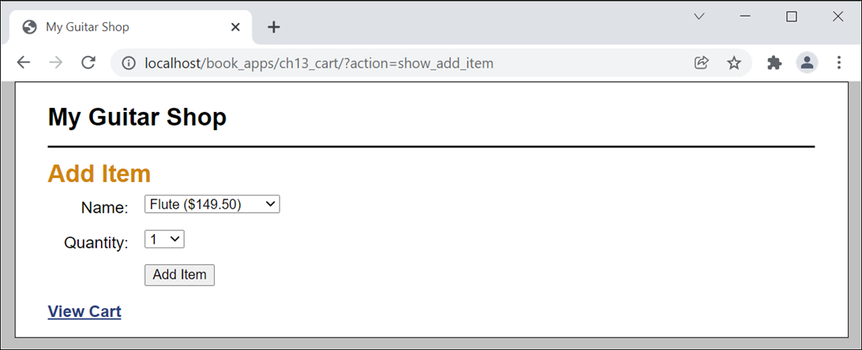
The Add Item page

Slide 52
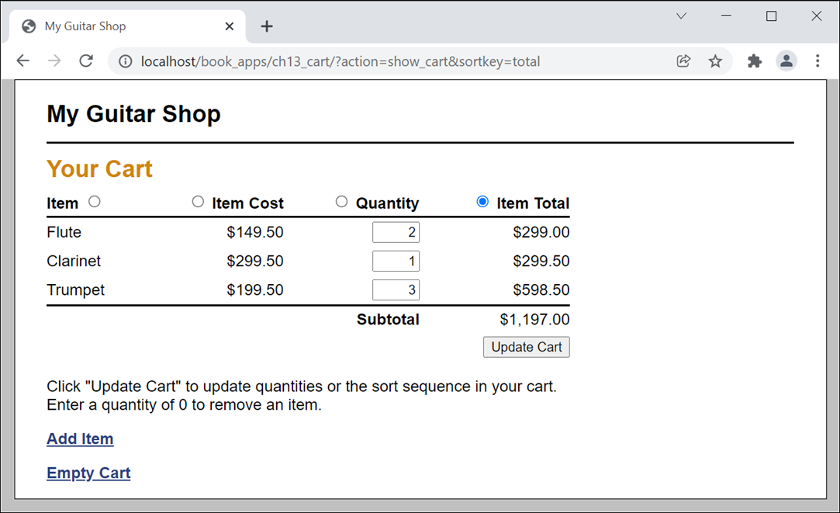
The Cart page

Slide 53
The cart.php file (part 1)
<?php
namespace cart {
// Add an item to the cart
function add_item(string $key, int $quantity,
array $product) {
// Same code as cart application for chapter 12
}
// Update an item in the cart
function update_item(string $key, int $quantity) {
// Same code as cart application for chapter 12
}
// Get cart subtotal
function get_subtotal () {
// Same code as cart application for chapter 12
}

Slide 54
The cart.php file (part 2)
// Get a function for sorting the cart on the specified key
function compare_factory(string $sort_key) {
return fn($left, $right) =>
$left[$sort_key] <=> $right[$sort_key];
}
// Sort the cart on the specified key
function sort(string $sort_key) {
$sort_function = compare_factory($sort_key);
uasort($_SESSION['cart13'], $sort_function);
}
}
?>

Slide 55
The index.php file (part 1)
<?php
require_once('cart.php');
// Start session and create a cart array if needed
session_start();
if (empty($_SESSION['cart13'])) { $_SESSION['cart13'] = []; }
// Create a table of products
$products = [
'MMS-1754' => ['name' => 'Flute', 'cost' => '149.50'],
'MMS-6289' => ['name' => 'Trumpet', 'cost' => '199.50'],
'MMS-3408' => ['name' => 'Clarinet', 'cost' => '299.50'],
];
// Get the sort key
$sort_key = filter_input(INPUT_POST, 'sortkey');
if ($sort_key === NULL) {
$sort_key = filter_input(INPUT_GET, 'sortkey');
if ($sort_key === NULL) {
$sort_key = 'name';
}
}

Slide 56
The index.php file (part 2)
// Get the action to perform
$action = filter_input(INPUT_POST, 'action');
if ($action === NULL) {
$action = filter_input(INPUT_GET, 'action');
if ($action === NULL) {
$action = 'show_add_item';
}
}
switch($action) {
case 'add':
$key = filter_input(INPUT_POST, 'productkey');
$quantity = filter_input(INPUT_POST, 'itemqty');
$product = $products[$key];
cart\add_item($key, $quantity, $product);
header('Location: .?action=show_cart');
break;

Slide 57
The index.php file (part 3)
case 'update':
$new_qty_list = filter_input(INPUT_POST, 'newqty',
FILTER_DEFAULT, FILTER_REQUIRE_ARRAY);
foreach($new_qty_list as $key => $qty) {
if ($_SESSION['cart13'][$key]['qty'] != $qty) {
cart\update_item($key, $qty);
}
}
header('Location: .?action=show_cart&sortkey='.$sort_key);
break;
case 'show_cart':
cart\sort($sort_key);
include('cart_view.php');
break;
case 'show_add_item':
include('add_item_view.php');
break;
case 'empty_cart':
unset($_SESSION['cart13']);
include('cart_view.php');
break;
}
?>

Slide 58
The cart_view.php file (part 1)
<!DOCTYPE html>
<html>
<head>
<title>My Guitar Shop</title>
<link rel="stylesheet" type="text/css" href="main.css">
</head>
<body>
<header>
<h1>My Guitar Shop</h1>
</header>
<main>
<h1>Your Cart</h1>
<?php if (empty($_SESSION['cart13']) ||
count($_SESSION['cart13']) == 0) : ?>
<p>There are no items in your cart.</p>
<?php else: ?>

Slide 59
The cart_view.php file (part 2)
<form action="." method="post">
<input type="hidden" name="action"
value="update">
<table>
<tr id="cart_header">
<th class="left">
Item <input type="radio"
<?php if ($sort_key == 'name') : ?>
checked
<?php endif; ?>
name="sortkey" value="name"></th>
<th class="right">
<input type="radio"
<?php if ($sort_key == 'cost') : ?>
checked
<?php endif; ?>
name="sortkey" value="cost">
Item Cost</th>

Slide 60
The cart_view.php file (part 3)
<th class="right" >
<input type="radio"
<?php if ($sort_key == 'qty') : ?>
checked
<?php endif; ?>
name="sortkey" value="qty">
Quantity</th>
<th class="right">
<input type="radio"
<?php if ($sort_key == 'total') : ?>
checked
<?php endif; ?>
name="sortkey" value="total">
Item Total</th>
</tr>

Slide 61
The cart_view.php file (part 4)
<?php foreach( $sort_key
as $key => $item ) :
$cost =
number_format($item['cost'], 2);
$total =
number_format($item['total'], 2);
?>
<tr>
<td>
<?php echo $item['name']; ?>
</td>
<td class="right">
$<?php echo $cost; ?>
</td>
<td class="right">
<input type="text" class="cart_qty"
name="newqty[<?php echo $key; ?>]"
value=
"<?php echo $item['qty']; ?>">
</td>

Slide 62
The cart_view.php file (part 5)
<td class="right">
$<?php echo $total; ?>
</td>
</tr>
<?php endforeach; ?>
<tr id="cart_footer">
<td colspan="3"><b>Subtotal</b></td>
<td>$<?php echo cart\get_subtotal(); ?>
</td>
</tr>
<tr>
<td colspan="4" class="right">
<input type="submit"
value="Update Cart">
</td>
</tr>
</table>

Slide 63
The cart_view.php file (part 6)
<p>Click "Update Cart" to update quantities or
the sort sequence in your cart.<br>Enter a
quantity of 0 to remove an item.
</p>
</form>
<?php endif; ?>
<p><a href=".?action=show_add_item">Add Item</a>
</p>
<p><a href=".?action=empty_cart">Empty Cart</a></p>
</main>
</body>
</html>

